Slide 1
Affordance
Computer Vision Laboratory University of Maryland

Slide 2
Was (from form to function)
Is (incorporate the object/tool in the action)
Will be (rules of contact, grammar of forces)

Slide 3
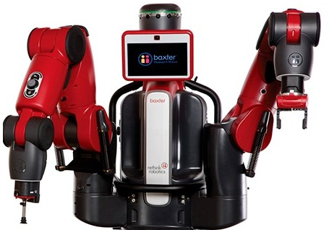
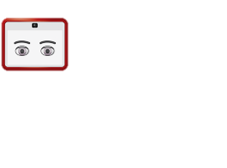
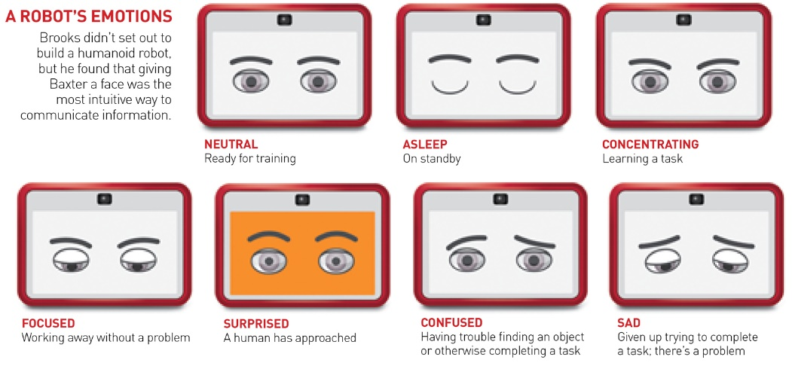
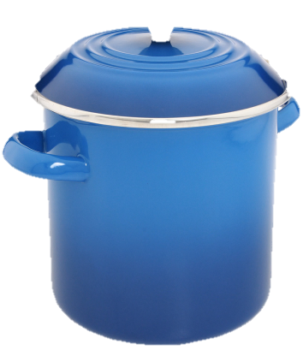
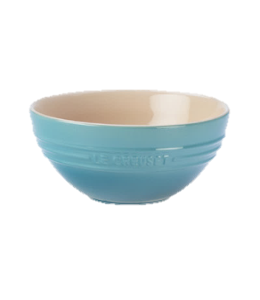
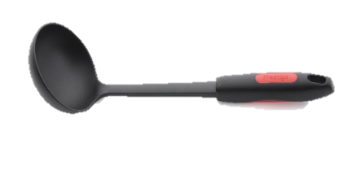
Baxter, please pour me some soup.
Notes:
Imagine Baxter is in a kitchen, and I ask (click) Baxter, please pour me some soup.
Baxter needs to find a ladle, grab the handle, dip the bowl of the ladle into the pot, and transfer the soup to the serving bowl. But what if the ladle in this kitchen has a different shape and color from the ladles that Baxter has seen before? What if Baxter has never seen any ladles at all? (click)

Slide 4
Baxter, please pour me some soup.
Mixing Bowl?
Robots need to know how tools and their parts can be used!
Object3?
Object4?
Object5?
Ladle: 64%
Spatula: 23%
Notes:
Today, computer vision algorithms could help Baxter recognize the ladle, (click) providing a bounding box in the image. However, in these situations Baxter needs to not only find the ladle, but (click) more importantly he needs to know which part of the ladle he can grasp, and which part of the ladle can contain the soup.

Slide 5
Baxter, please pour me some soup.
Robots need to know how tools and their parts can be used!
Notes:
In this work we present a novel problem of localizing and identifying part affordance, where a robot can explain how an object and its parts can be used and generalize this knowledge about functionality to completely novel object categories.

Slide 6
“If you know what can be done with a[n] object, what it can be used for, you can call it whatever you please”
J. Gibson
Notes:
As Gibson remarked

Slide 7
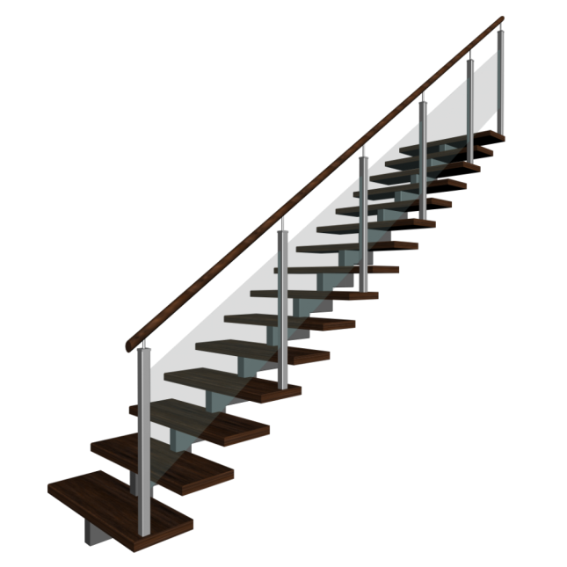
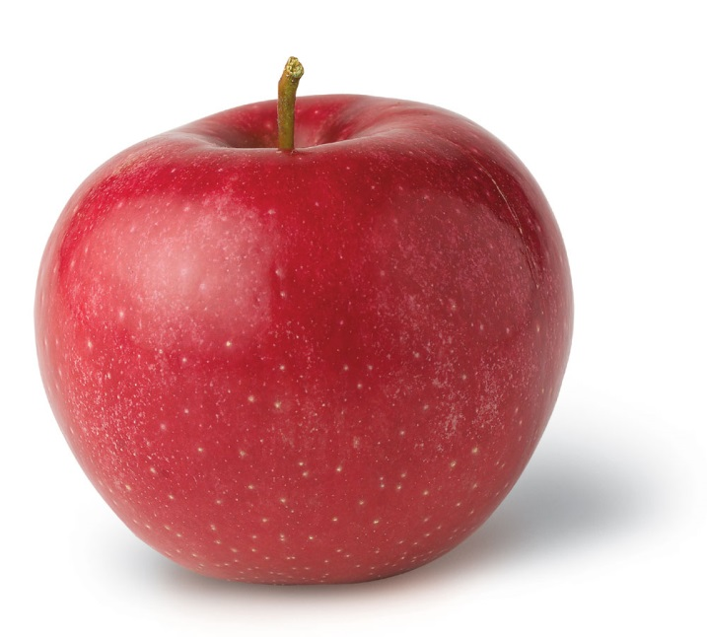
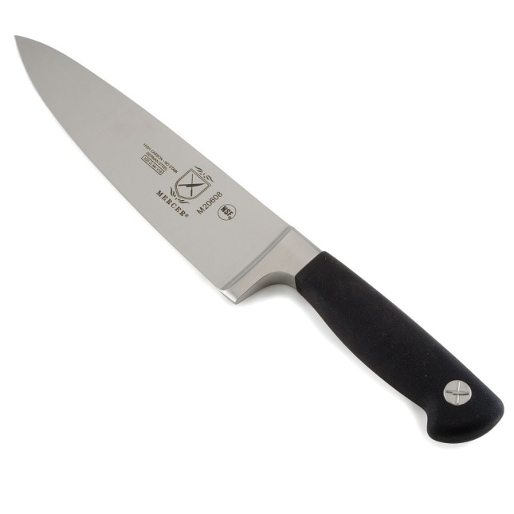
AffordanceS
The latent “action possibilities” available to an agent, given their capabilities and the environment.

Slide 8
Effective AffordanceS
The latent “action possibilities” of an object, that allow an agent to effect change in other objects.

Slide 9
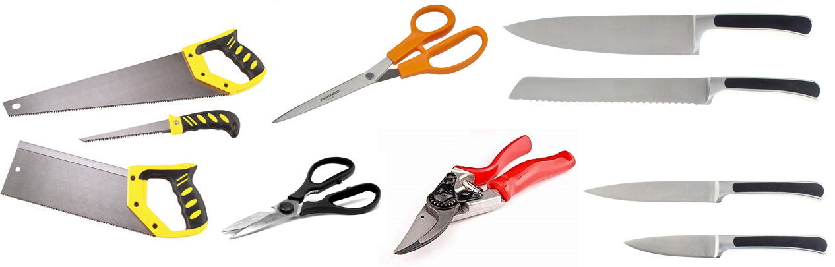
Challenges
Notes:
From a computer vision perspective this is a major challenge because (click) objects from many different categories share affordances.

Slide 10

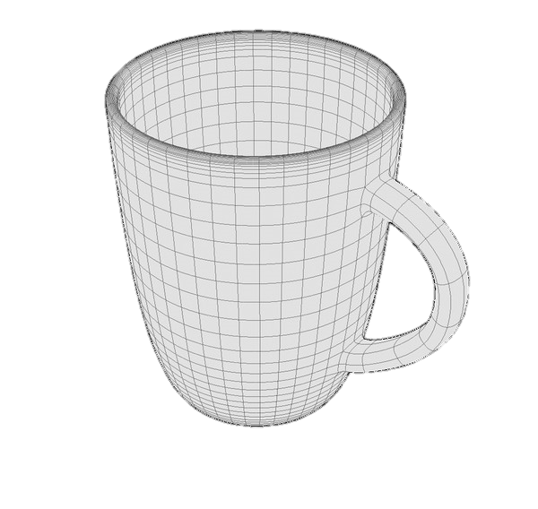
Geometry is Major key to predicting part affordance
Notes:
And we need precise 3d locations to be useful for a robot

Slide 11
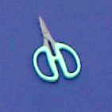
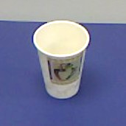
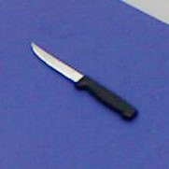
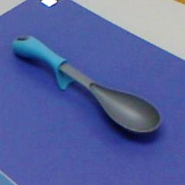
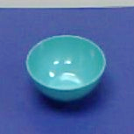
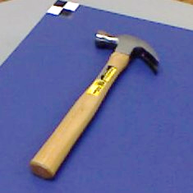
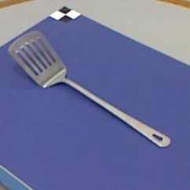
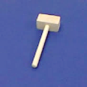
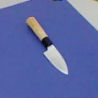
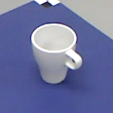
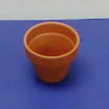
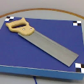
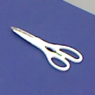
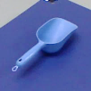
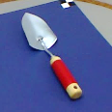
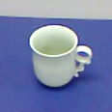
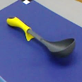
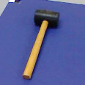
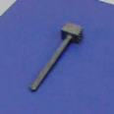
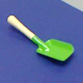
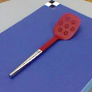
RGB-D Part Affordance Dataset
105 kitchen, workshop, and garden tools from 17 object categories.
More than 10,000 RGB-D frames with hand labeled ground truth.
grasp
grasp-wrap
cut
scoop
contain
pound
support
Myers, CL. Teo, C Fermüller, and YiAloimonos Affordance Detection of Tool Parts from
Geometric Features, ICRA 2015.

Slide 12
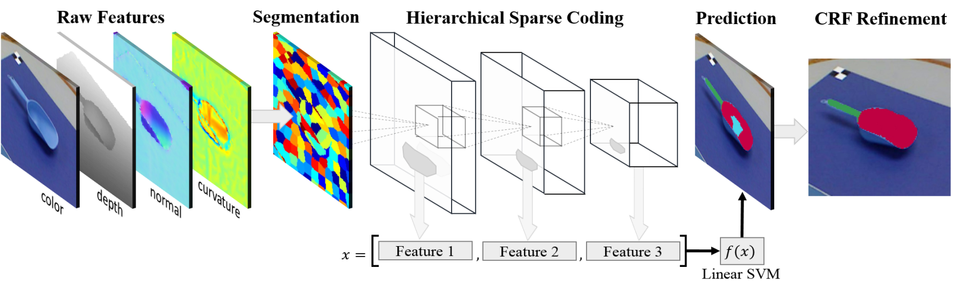
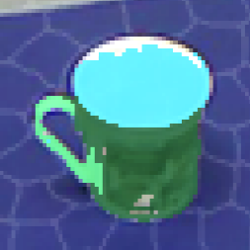
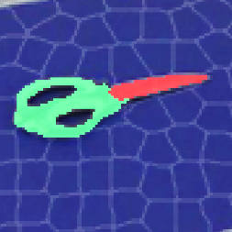
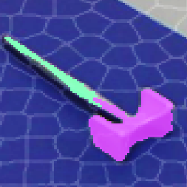
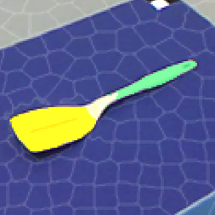
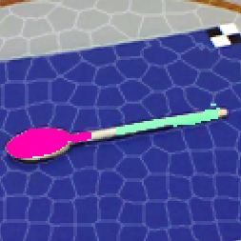


Affordance of Object Parts from Geometric Features
Using hierarchical matching pursuit (M-HMP)
by Bo et al[3]
Notes:
We propose a framework which extracts hierarchical sparse codes from RGB-D image superpixels, which provides precise 3D function information that can be used by a robot.
12

Slide 13
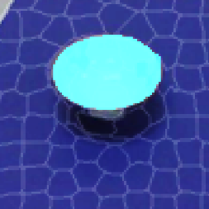
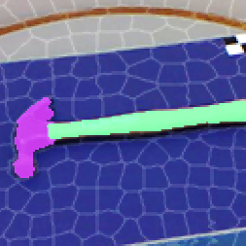
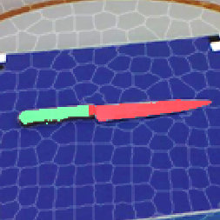
SUCCESSFUL Results
grasp
wrap-grasp
cut
scoop
contain
pound
support

Slide 14
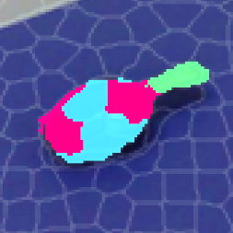
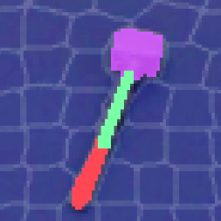
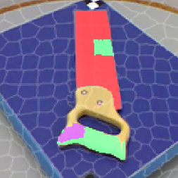
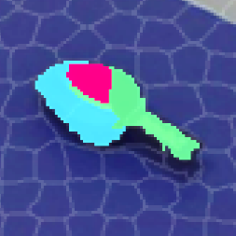
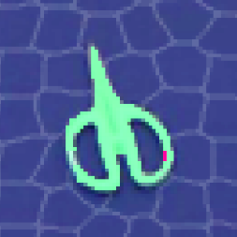
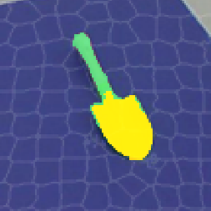
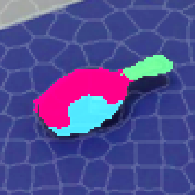
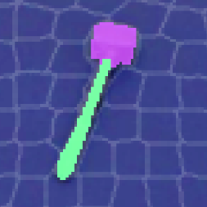
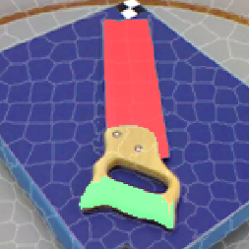



Results
Refinement
Errors
All
All + CRF
grasp
wrap-grasp
cut
scoop
contain
pound
support
Notes:
Crf give little q improvement but refines for usefulness with robots. Errors kind of make sense

Slide 15

USING STRUCTURED RaNDOM FOREST CLASSIFIERS

Slide 16






Local geometric features
Cleaned Depth and Surface normals
Principal curvatures
Shape Index (SI) + Curvedness (CV)
[Koenderink & van Doorn, IVC’92]
Notes:
We extract 4 types of geometric features from RGB-Depth data:
#C – First, we extract 2D depth edges, that is where changes in depth occurs and construct a Histogram of Gradients along these edges. We also extract surface normals from the depth data.
#C – Next, we compute principal curvatures, that yields a local measure of surface cuvature,
#C – We also compute a intrinsic shape measure known as the shape index and its associated curvedness measure. The shape index is a local measure that captures surface deformations.
#C→

Slide 17




Generalization
Pounding
Cutting

Slide 18



Contain
Graspable

Slide 19





Results
Our data set
Cornell Grasping Dataset
[Lenz et al, IJRR’15]
is the weighted F measure, r_{a} is recognition accuracy, d_{a} is detection accuracy
Notes:
Here we show some results of the SRF predictions and we compare it to predictions using a slower approach termed the Superpixel-HMP introduced by our colleague Austin. We show here results of various feature ablations and we note that not only is our SRF approach more accurate , it is much faster than S-HMP which classifies sparse features using a SVM over superpixels in the image.
#C – we also applied the SRF for a more restricted task of detecting graspable regions and compared it to a state-of-the-art deep learning approach of Lenz et al., known as the Sparse AutoEncoder (SAE). We note here that SRF’s recognition and detection accuracies are comparable to SAE and S-HMP while being orders of magnitude faster in this dataset.
#C→

Slide 20


Slide 21

Grasp TYPE and INTENTION

Slide 22


Slide 23
HAND GRASP TYPES

Slide 24
Why grasp types?
Feature for action recognition
Feature for temporal segmentation -> different actions
Encodes information about user intention
To enable real-time Prediction
Simulate movement on the robot

Slide 25

Experiment on grasp type intention with Amazon Turkers

Slide 26




Experiment on grasp type intention with Amazon Turkers
An example
Question 1 out of 39
Please select the hand grasp type used in one of the three action categories
Does the grasp type reveal action intention? Y .Zhang, Y. Yang, C. Fermüller and Y. Aloimonos, VSS 2015

Slide 27

57 subjects participated, and 48 were considered valid responses
Humans accuracy in classification

Slide 28
Conclusions of the experiment
Accuracy of action classification nearly same for hand patches and whole image (71% vs 77%)
Accuracy decreased significantly when subjects saw segmented hands (54%)
(significant 99.9%on t-test)
Findings confirm importance of grasp type as symbolic feature

Slide 29


Slide 30

Computational algorithm [2]
Detect hand patches [1]
Classify the grasp type using a Convolutional Neural network (CNN) of 5 layers -> 7 dim. prob. vectors for each patch (P_{GraspType1} and P_{GraspType2})
Derive action intention as 3-dim prob. vector P_{int} using SVM: P_{Int} = f(P_{GraspType1}; P_{GraspType2}|θ)
with θ model parameters from labeled data
Results
[1] A. Mittal, A. Zisserman, and P. H. Torr. Hand detection using multiple proposals. In BMVC, pages 1–11. Citeseer, 2011.
[2] Y. Yang, C. Fermüller, Y. Li and Y. Aloimonos : Grasp Type Revisited: A Modern Perspective on A Classical Feature for Vision, CVPR 2015.

Slide 31

Grasp pose classification

Slide 32

Segmentation in time

Slide 33

Action Fine Level Segmentation

Slide 34
Thank You

